Slide 1
Managing Information Technology Resources ITWS 4310
Significant Digits
Network Effects
Communications Technology
October 4, 2018

Slide 2
Managing IT Resources Class Outline: Thu, Oct 4, 2018
MITR Term Project
Schedule Meetings with Client and Invite Faculty to Meetings
Work on “System Requirements” with Client, “Risk Management Plan”, and updated CBA, all due as part of “Initial Sections” due Tues Oct 9 by 9:00 PM
Mid-Term Exam on Monday Oct 15 during class from 10 AM – 11:50 AM
See past Mid-Term Exams posted on LMS
How to Do a Business Case – 1st Business Case is “Netflix” with Case Answers due prior to class (9:59 AM) on Tues Oct 9
Current Events
A Practical Guide to Significant Digits: Accuracy vs. Precision
Finish Cloud Computing from Monday
Chapter 8: Platforms, Network Effects, and Competing in a Winner-Take-All World
Chapter 16: A Manager’s Guide to the Internet and Telecommunications

Slide 3
Managing IT Resources: ITWS 4310 Term Project Report Outline
Section 1: Executive Summary
Section 2: Introduction
Section 3: Client Organization and Description
Section 4: Project Team
Section 5: Problem Statement
Section 6: IS/IT Solution
Section 7: Methodology
Section 8: IS/IT Requirements
Section 9: IS/IT Design
Section 10: Cost-Benefit Analysis with (Risk Mgmt)
Section 11: Project Plan/Schedule/Resources
Section 12: Post-Turnover Plan
Section 13: Results and Client Feedback
Section 14: Conclusions
Improve based on assignment feedback
Update based on new information
Add “requirements”
Add “risk management” as part of CBA section
Integrate and make flow as sections of one document
Project Proposal:
Requirements
Part of Initial Sections:
due Oct 9 by 9 PM
Cost-Benefit Analysis
Project Plan

Slide 4
Business Case Analysis
Read the Case.
The Case is a “story” about a relevant IT company or situation intended to provide experiential learning about the topics in this course.
Read the Case Questions.
Re-read the case with the questions in mind.
Research material about the company on its website, financial sites (www.reuters.com/finance/stocks, www.google.com/finance, www.finance.yahoo.com), and other current media.
Think about the Case questions. You are encouraged to meet in groups to discuss the case questions.
Be prepared to discuss and answer all the Case Questions during class.
Write and submit the answer to the one written Case question that is to be submitted on LMS individually prior to class.

Slide 5
How to Write the Business Case
Do not simply summarize the Case.
Be sure to Answer the Question(s).
The length should be 1-2 pages, single-spaced, 12 point font with normal borders.
Use both qualitative and quantitative arguments to support your answer.
Use concepts and data from the Case and the FWK textbook.
Use concepts and data from online research.
Show insight. It is ok to include personal knowledge.
Words without numbers are fair at best.
Numbers without words are fair at best.
Use good quality English language: style, rhetoric, grammar, spelling, references.

Slide 6
Current Events: What is happening this week?

Slide 7
Significant Figures: Accuracy vs. Precision in Calculations
Significant figures give an indication of the precision attained when taking measurements.
Significant figures include a number of certain digits, and a final digit that is estimated or rounded off, and is questionable.
Any properly recorded measurement can be said to have a maximum uncertainty or error of plus or minus one-half its last digit.
The result of an arithmetic calculation can not have more precision than the least precise number in the calculation.

Slide 8
Chapter 14
Software in Flux: open source, cloud, and virtualized and app-driven shifts

Slide 9
What are advantages of Open Source Software?
Advantages
Low cost
Increased reliability
Improved security and auditing
System scalability
Firms can improve time to market
Fewer bugs due to large number persons looking at code

Slide 10
What are disadvantages of Open Source Software?
Disadvantages
Support not included in the free or lowest cost models
Sometimes difficult to install and maintain
For vendors: no proprietary competitive advantage
For vendors: reduces revenues
Complexity of some products
Total cost of ownership increases for some products
Legal and licensing concerns

Slide 11
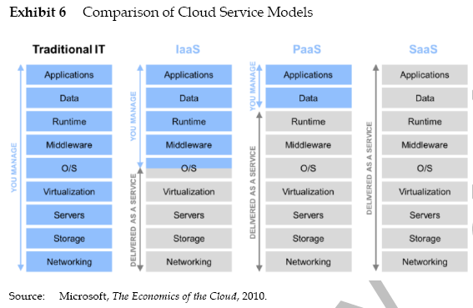
Cloud Service Models

Slide 12
What are advantages of “The Cloud”?
Advantages
Lower costs by reducing software, hardware, maintenance and staff expenses
Financial risk mitigation
Potentially faster deployment
Variable expenses instead of Capital Expenses
Scalable systems
Higher quality and service through instant upgrades
Remote access and availability

Slide 13
Benefits of SaaS to users
Lower costs and financial risk mitigation.
Faster deployment times and variable operating expense.
Scalable systems.
Higher quality and service levels.
Remote access and availability.
Limits development to a single platform.
Tighter feedback loop.
Ability to instantly deploy bug fixes and product enhancements.
Lower distribution costs.
Greater accessibility.
Reducing software piracy.

Slide 14
What are disadvantages of “The Cloud”?
Disadvantages
Dependence on single vendor
Viability of partner firms
Forced to move to newer versions
Reliance on network connections
Limited customization
Sometimes higher life cycle costs

Slide 15
Risks Associated with SaaS
Dependence on a single vendor.
Concern about the long-term viability of partner firms.
Users may be forced to migrate to new versions.
Possibly incurring unforeseen training costs and shifts in operating procedures.
Reliance on a network connection, which may be slower, less stable, and less secure.
Data assets stored off-site may lead to security and legal concerns.
Limited configuration, customization, and system integration options compared to packaged software or alternatives developed in-house.
User interface of Web-based software is less sophisticated and lacks the richness of most desktop alternatives.
Ease of adoption may lead to pockets of unauthorized IT being used throughout a firm.

Slide 16
Earning Money Through SaaS
Money can be earned via a usage-based pricing model similar to a monthly subscription.
Other SaaS firms:
Offer free services that are supported by advertising.
Promote the sale of upgraded or premium versions for additional fees.
Compete directly with the biggest names in software.

Slide 17
Cloud Offerings
Hardware and software exists “in the cloud,” meaning somewhere on the Internet.
You only pay for the amount of processing, storage, and telecommunications used.
Cloud vendors typically host your software on their systems.
Cloud computing efforts focus on providing a virtual replacement for a subset of operational hardware like storage and backup solutions.
SaaS provides the software and hardware to replace an internal information system.
A firm replaces software and hardware with a service provided by a third party online.

Slide 18

Cloud services
Examples of hardware cloud services:
Salesforce.com offers Force.com.
Includes several cloud-supporting tools to write applications specifically tailored for Web-based delivery.
Google’s App Engine offers developers several tools.
Including a database product called Big Table.
Microsoft offers Windows Azure.

Slide 19
Cloud Providers
Platform as a service (PaaS): Cloud providers offer services for customers to build their own applications on the provider’s infrastructure.
Services include hardware, operating system, tools, and hosting.
Infrastructure as a service (IaaS): Cloud providers offer services that include running the remote hardware, storage, and networking.
Client firms can choose the software used.
Estimated Monthly Costs to Run a Website with 50 Million Monthly Page Views.

Slide 20
Clouds in Action
CLOUDBURSTING
Use of cloud computing to provide excess capacity during periods of spiking demand.
BLACK SWANS
Events that cannot be predicted but can cause an impact.
It is a scalability solution that is provided as an overflow service, kicking in as needed.
Scalable computing resources can help a firm deal with spiking impact from Black swan events.

Slide 21
Cloud Computing Challenges
Installing a complex set of systems on someone else’s hardware is very difficult.
Firms considering cloud computing need to do a thorough financial analysis.
Firms should enter the cloud cautiously, particularly where mission-critical systems are concerned.

Slide 22
Clouds and Tech Industry Impact
Shifting to cloud computing modifies the margin structure for many in the computing industry.
Cloud computing can accelerate innovation.
Changes the desired skills mix and job outlook for IS workers.
Enables organizations to spend less on hardware infrastructure and reinvest in strategic efforts and innovation.
Firms need to think about the strategic advantages that can be created.
This server-packed shipping container from
Oracle’s Sun unit is designed for rapid data
center deployment.

Slide 23
CHAPTER 8
Platforms, Network Effects, and Competing in a Winner-Take-All World

Slide 24
Learning Objectives
Define network effects
Recognize products and services that are subject to network effects
Identify the three primary sources of value for network effects
Understand the factors that add value to products and services subject to network effects
Recognize factors that contribute to the staying power and complementary benefits of a product or service subject to network effects

Slide 25
Learning Objectives
Understand how competition in markets where network effects are present differ from competition in traditional markets
Understand the reasons why it is so difficult for late-moving, incompatible rivals to compete in markets dominated by a proprietary standard
Plot strategies for competing in markets where network effects are present, both from the perspective of the incumbent firm and the new market entrant

Slide 26
Network Effects
What are Network Effects?
What is Metcalfe’s Law?

Slide 27
What are three Sources of Value that Drive Network Effects?

Slide 28
Explain why/how network effects impacted the following products or services:
Microsoft Office
Facebook
eBay

Slide 29
What is the difference between “One-sided” and “Two-sided” markets?

Slide 30
How are markets that are subject to network effects different?

Slide 31
How do Standards impact Network Effects?
Proprietary Standards
Open Standards

Slide 32

Strategies for Competing in Markets with Network Effects
Move early (Yahoo! Auctions in Japan).
Subsidize product adoption (PayPal).
Leverage viral promotion (Skype, WhatsApp, Uber, Airbnb, Blue apron).
Expand by redefining the market to bring in new categories of users (Nintendo Wii) or through convergence (iPhone).
convergence: When two or more markets, once considered distinctly separate, begin to offer similar features and capabilities.
envelopment: When one market attempts to conquer a new market by making it a subset, component, or feature of its primary offering.
Form alliances and partnerships (NYCE vs. Citibank)
Establish distribution channels (Java with Netscape, Microsoft bundling Media Player with Windows).

Slide 33
Strategies for Competing in Markets with Network Effects (cont’d)
Seed the market with complements (Blu-ray, Nintendo, thredUP).
Encourage the development of complementary goods—this can include offering resources, subsidies, reduced fees, market research, development kits, and training (Oculus and Amazon Echo developer funds, Apple Swift Playgrounds).
Maintain backward compatibility (Apple’s Mac OS X Rosetta translation software for PowerPC to Intel, Samsung Pay using existing mag-stripe standards).
backward compatibility: Ability to use complementary products developed for a prior generation of technology.
adaptor: Product that allows a firm to use the complementary products, data, or user base of another product or service.

Slide 34
Strategies for Competing in Markets with Network Effects (cont’d)
For rivals, maintain compatibility with larger networks (Apple’s move to Intel)
For incumbents, constantly innovate to create a moving target and block rival efforts to access your network (Apple’s efforts to block access to its own systems).
For large firms with well-known followers, make preannouncements (Microsoft, Apple)
The Osborne Effect: Firm experiencing a sharp and detrimental drop in the sales of current offerings due to its preannouncement of forthcoming products.
congestion effects: Increasing numbers of users to lower the value of a product or service.

Slide 35
CHAPTER 16
A Manager’s Guide to the Internet and Telecommunications

Slide 36
What are the key points in Chapter 16, “A Manager’s Guide to the Internet and Telecommunications”

Slide 37
Internet service provider (isp)
Internet service provider (ISP): Organization or firm that provides access to the internet.
Connect to one another, exchanging traffic.
Ensure that messages can get to any other computer that’s online and willing to communicate.

Slide 38
The Internet Is a Network of Networks
In this diagram, the “state.edu” campus network is connected to other networks of the Internet via two ISPs: Cogent and Verizon.

Slide 39
There’s Another Internet?
Internet2 is a research network created by a consortium of research, academic, industry, and government firms.
These organizations have collectively set up a high-performance network running at speeds of up to one hundred gigabits per second to support and experiment with demanding applications.

Slide 40
What is the “Last Mile Problem”

Slide 41
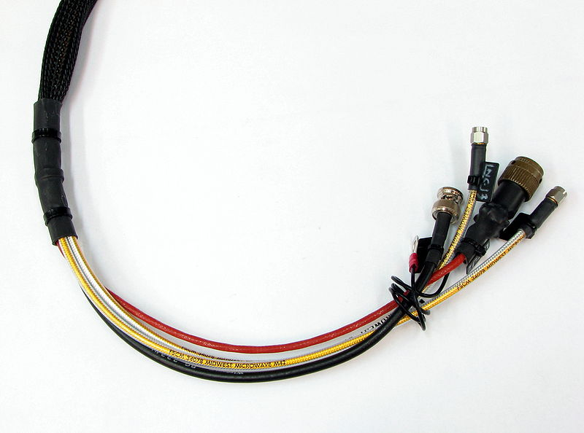
Cable broadband
Uses thick copper wire to offer broadband access.
Coaxial cable: Insulated copper cable used by television providers.
Has shielding that reduces electrical interference.
Allows cable signals to travel longer distances without degrading and with less chance of interference.
Limitation: Requires customers to share bandwidth with neighbors.

Slide 42
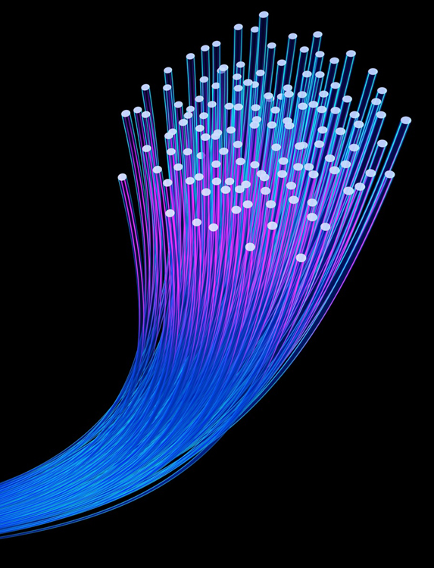
Fiber to the Home (FTTH)
Broadband service provided via light-transmitting fiber-optic cables.
Fastest last-mile technology and works easily over long distances.
Limitations:
Need to build fiber infrastructure from scratch.
Cost of building is enormous.

Slide 43
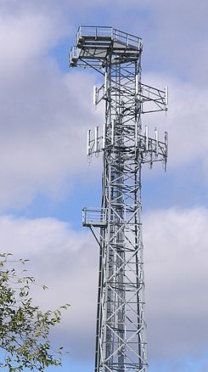
Wireless
Mobile wireless service from cell phone access providers is delivered via cell towers.
Providers require a wireless spectrum.
Wireless spectrum: electromagnetic frequencies used for communication.
Most mobile cell phone services have to license spectrum.
High-stakes regional bidding wars whenever governments put new spectrum up for license

Slide 44
Average Demand Usage by Function
Usage | Demand
Voice Calls | 4 MB/hr.
iPhone Browsing | 40–60 MB/hr.
Net Radio | 60 MB/hr.
YouTube | 200–400 MB/hr.
Conventional mobile phones use an estimated 100 MB/month, iPhones 560 MB/month, and iPads almost 1 GB/month.
Source: Based on information from R. Farzad, “The Truth about Bandwidth,” BusinessWeek, February 3, 2010.

Slide 45
Wi-Fi and Other Hotspots
Wi-Fi: Wireless local-area networking devices
Stands for wireless fidelity.
Wi-Fi antennas are built into their chipsets.
To connect to the Internet, a device needs to be within range of a base station or hotspot.
Wi-Fi base stations used in the home are usually bought by end users.
They are then connected to a cable, DSL, or fiber provider.
Wi-Fi equipped mobile devices also offer an opportunity to act as a personal hotspot.
Connect to the Internet via the cell network
Allow nearby devices to also connect to the Internet.
Bluetooth: a standard for short-range wireless connectivity, typically meant to eliminate cabling used for things like speakers, printers, cameras, etc…

